Slide 1
HMIS End User Workgroup
Cleveland/Cuyahoga County Office of Homeless Services
9/20/2024

Slide 2
Housekeeping
This workgroup will be recorded and made available on OHS’s website by early next week.
Please stay muted.
If you have a question:
“Raise your hand” function
Put it in the chat
Information shared in this workgroup should be disseminated to all HMIS end users regardless of their attendance today.

Slide 3
Housekeeping
New HMIS System Administrator – AMANDA LARSON
Please be sure to include Amanda on all communication about HMIS- and data-related issues!
Nick should remain cc’d on communication.

Slide 4
Agenda
Social Security Numbers Update
Uploading Files into HMIS
Referrals in HMIS
Outreach Module
Data Quality Monitoring
Coming Soon!
Live Q&A
NEW ELEMENT – Lease Signed Date

Slide 5
Social Security Numbers Update
Notes:
Amanda

Slide 6
SSN Updated Logic
When entering an SSN for a participant, the system will check to see if the SSN is valid based on SSA guidelines
Invalid SSNs:
Last 4 digits are 0000
First 3 digits are 000, 666, or start with 9
Middle digits are 00
Digits are repetitive
Digits are sequential
Updated requirement for unknown/refused SSNs
Instead of entering “0” for unknown numbers, enter “x”.
If all digits are “x”, system will automatically change the “data quality of SSN” field to “client doesn’t know”
If some digits are “x”, system will automatically change the “data quality of SSN” field to “approximate or partial SSN reported”

Slide 7
Uploading Files in HMIS
Notes:
Amanda

Slide 8
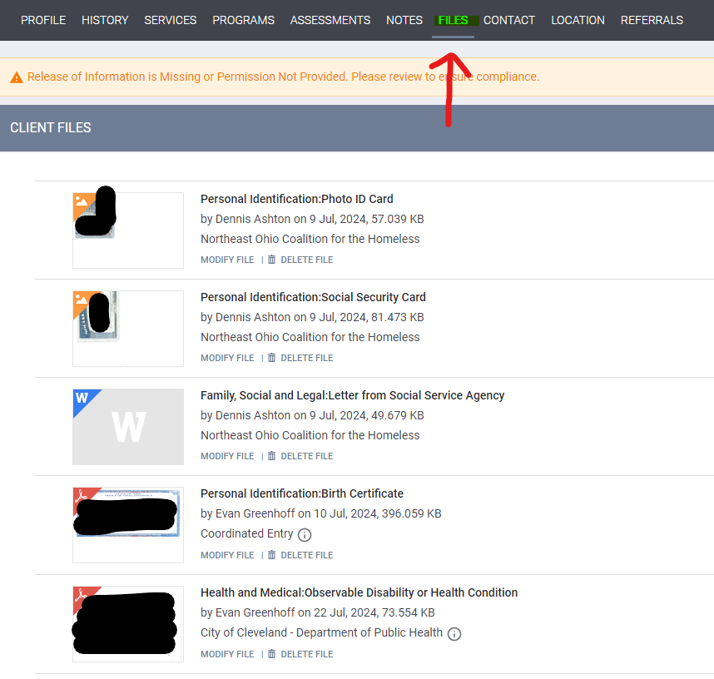
Files
Where?
Client- or program-level uploads
What?
Any file can be uploaded if it does not exceed 25 MB
Consider uploading identifying documents (IDs, birth certificates, & SS cards)
Will be integral in new housing application process
Who?
Anyone with edit access within an agency

Slide 9
Referrals in HMIS
Notes:
Nick

Slide 10
Referrals
Responsibility of Agency
Locating and Handling Referrals in HMIS
All agencies are responsible for checking on the referrals made to them by Coordinated Entry.
Specifically, agency admins will be responsible for this function and will the primary contact as with most HMIS issues.
Once referral is known, agencies are also responsible for outreaching the person using contact information provided at CE.
On the SEARCH screen, the REFERRALS tab is in the upper right corner.
Pending referrals will be shown once REFERRALS is clicked.
Referrals will be automatically denied and expired after 30 days of no activity (services entered, assessments completed, etc.
To satisfy the referral, agencies must enroll the participant in the referred to program.

Slide 11
Outreach Module
Notes:
Nick

Slide 12
Outreach Module
A geolocation-based module within our instance of Clarity.
A new, innovative way to track those experiencing unsheltered homelessness on a map.
Includes program enrollments into encampments to track days homeless better.
Limited access to those who provide outreach services.
There is a role for ALL end users, though!

Slide 13
Outreach Module
The Location Tab
Current Living Situation Assessment
If you are certain that someone is unsheltered and know exactly where they are staying, you can add their geolocation on LOCATION tab.
By adding an address and a location within that address, the Outreach Module will reflect people on the map or within a known encampment.
For programs that require a CLS assessment, a location can be added using geolocation.
Once the CLS is completed, the Outreach Module will reflect the selected location on the map.

Slide 14
Data Quality Monitoring
Notes:
Amanda

Slide 15
DQ Monitoring Processes
OHS’s DQ Monitoring Process
PDF of APR is due to OHS via email by the 15th of every month.
Reporting period = previous month’s data
THIS IS ONLY TO MONITOR WHAT IS IN HMIS!
Agencies are also required to have an internal data quality monitoring process IN WRITING.
This process should focus on ensuring what is in internal records matches what is in HMIS.
Internal records
(EMRs, databases, etc.)
Clarity (HMIS)

Slide 16
Recurring Data Errors
Annual Assessments:
Sexual Orientation:
Exit Destinations:
If a participant has been enrolled in a project for more than 365 days, an annual assessment is needed.
To pull the aggregated data, the annual assessment must be completed within 30 calendar days of the enrollment anniversary date.
For example, if enrollment date is 1/7/2024, the annual assessment has to be completed between 12/8/2023 - 2/6/2024. Any assessment that is completed outside of that timeframe will be considered an error.
A required data element for PSH projects
Must be updated in the Program Enrollment
When End Users are making corrections on their Monthly APRs, it appears the Sexual Orientation is only being updated on the Profile screen.
Noticing more "NO EXIT INTERVIEW COMPLETED"
Please refrain from using this answer, as it shows up as missing data.
Can use HMIS to help determine where a participant might have gone after exiting your project.
Please refrain from using DATA NOT COLLECTED

Slide 17
NEW ELEMENT: Lease Signed Date
Notes:
Nick

Slide 18
Lease Signed Date
For RRH and PSH programs only
Starting 10/1/2024 – All active participants will need to have this entered on enrollment screen.
Lease Signed Date
Date on lease/date lease was signed by participant
Housing Move In Date
Date participant physically starts living in the unit

Slide 19
Coming Soon!
Notes:
Nick

Slide 20
Big Things Coming in HMIS
HMIS By-Name List
Coordinated Entry Redesign
All the spreadsheet BNLs in the continuum are going to be moved into HMIS!
Feedback session next week with BNL providers and final product/training to come near the end of October.
Requires all persons who need to be on the BNL to have an assessment completed by an end user.
Expanded access to CE through most single adult shelters and outreach providers.
Reconfiguring CE in HMIS to match the required needs from the redesign process.
Requires much closer attention to the availability of beds/units within all CoC programming.

Slide 21
Big Things Coming in HMIS
Universal Supportive Housing Application Process/Packet
Inventory Module
Multiple applications for different subsidized housing opportunities exist in our CoC.
Creation of a USHAP in HMIS that covers all required questions for all available units.
Requires end users to upload documents and complete the application within HMIS.
With USHAP, there is a need to have the inventory of all our housing programs in HMIS by unit.
The Inventory Module is the way to track each building/unit on a map, by subsidy type, and other identifying factors.
Requires housing providers to have HMIS end users add in information about unit availability and subsidy.

Slide 22
Big Things Coming in HMIS
NEW Clarity User Interface

Slide 23
Questions?

